Slide 1
I
MANAGEMENT INFORMATION SYSTEMS (WRBV302)
Online Revenue Models
Chapter 18
27 October 2021

Slide 2

II
Understand the shift to online advertising
Understand the Google search mechanism
Understand Google’s search advertising model and the cost structure
Understand how to make money from Google Ads
Understand privacy issues and ethics related to tracking and collecting user information
Learning Outcomes
Online Revenue Models| 27 October 2021

Slide 3
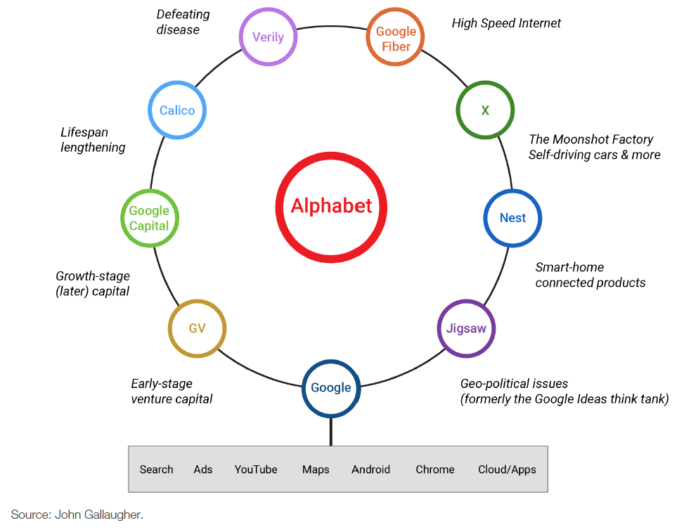
III
Google:
Market capitalization (firm’s value) – most valuable media company
Controls majority of Internet search advertising business
Google
Online Revenue Models| 27 October 2021

Slide 4
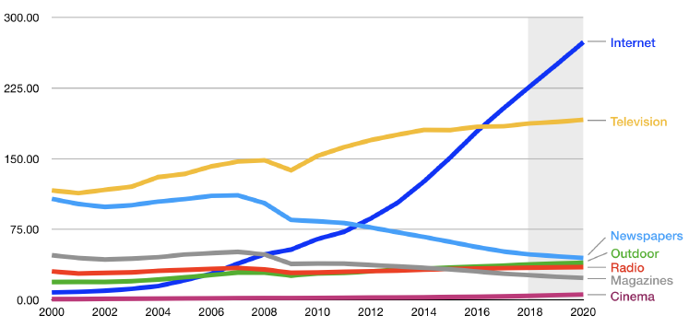
IV
Only advertising category showing consistent positive growth.
Shift to
Online Advertising
Online Revenue Models| 27 October 2021

Slide 5
V
Increased user time online
More time spent online than watching TV
Read fewer print publications
Less radio listeners
Online channels enable advertisers to reach consumers at work
Improved measurement and accountability
Can count user clicks and purchases via ad
Measurement metrics linked to payment, therefore more cost effective
Targeting
Easier to target users most likely to spend on product
Why the Increase in Online Ad Spending?
Online Revenue Models| 27 October 2021

Slide 6
VI
Organic or natural search
Search engine results returned and ranked according to relevance.
PageRank
Algorithm to rank websites.
Spiders, Web crawlers, Software robots
Traverse available websites to perform a given task. Spiders discover documents for indexing and retrieval.
How Google’s Search Mechanism Works
Online Revenue Models| 27 October 2021

Slide 7
SEM: Search Engine Marketing
Ads linked to search because term indicates user has an interest in topic
Keyword advertising
Text ads at right or top of search results
Targeted based on words in query
Advertisers bid on target words
Tying ads to purchasing intent
Formula for ranking ads:
Ad Rank = Maximum CPC x Quality Score
CPC: cost per click
Quality score: measure of ad performance
Calculation includes CTR (click through rate)
Generally: the more relevant the ad, the higher the quality score
Dynamic search ads
Google generated ads based on your web site
Useful if content changes a lot, or users likely to use wide range of search terms
Ad ranking and CPC calculated every time a user clicks
Advertisers get ad performance stats
Can monitor and update themselves
VII
How Google’s Search Advertising Works
Online Revenue Models| 27 October 2021

Slide 8
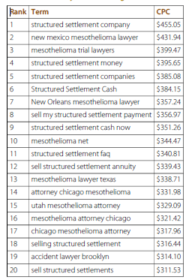
VIII
Most clicks between 30c and $1
Can vary depending on industry and current status
Rates determined by market related auction
How Much does it Cost?
Online Revenue Models| 27 October 2021

Slide 9
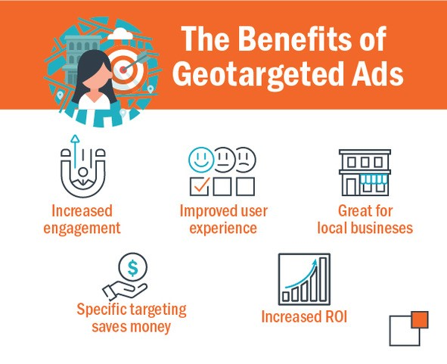
IX
Geotargeting
Advertisers specify user location
Country, state, metropolitan region or advertising region
IP address can be used for geotargeting
Use of Wi-Fi hotspots and GPS to identify location
Targeting by Location
Online Revenue Models| 27 October 2021
https://www.thundertech.com/blog-news/august-2020/how-to-use-geotargeted-ads-for-your-business

Slide 10
X
Google’s ad network links advertisers to a range of other sites, apps, games
Hosts are paid for hosting ads
Google manages advertisers, provides targeting technology, serves the ads and handles payment collection
Hosts just sign up online
Receive approx. 70c for every $1 Google gets
AdSense
Targets ads based on keywords detected in content
How to Make Money from Google Ads
Online Revenue Models| 27 October 2021

Slide 11
XI
Privacy advocates also worry that the amount of data stored by Google
Google provides features that allow users control ad settings.
Google is now taking a more active public relations and lobbying role
Privacy Concerns
Online Revenue Models| 27 October 2021

Slide 12
XII
Chapter 11: Section 4 & Chapter 18
What are the issues that are likely to pose the greatest challenges for making money via online advertising (both for Google/Facebook and participants in their ad network)?
What do you (as a future IS manager) need to pay attention to regarding advertising online, as well as how social media and “free” online tools generate revenue?
Assignment
Online Revenue Models| 27 October 2021
Submit to Moodle by Wednesday 9am.

